Slide 1
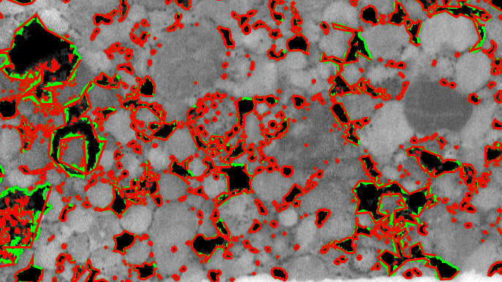
TEAM: EXTRATERRESTRIAL EFFERVESCENCE
CHALLENGE: 2D/3D METEORITE STRUCTURES

Slide 2
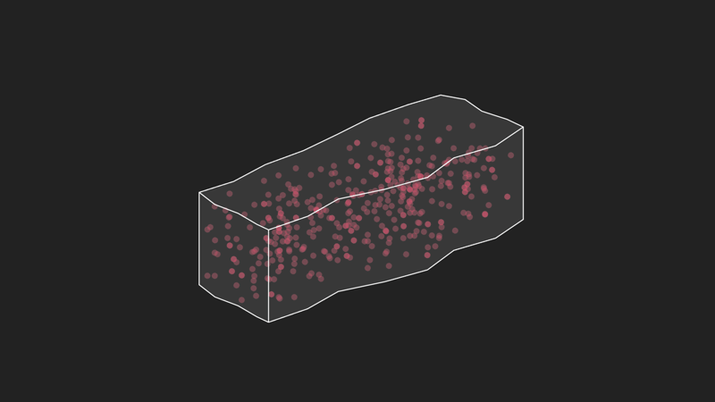
AIM:
Locate chondrules (bubbles)
in a CT-scanned meteorite using computer vision
TEAM: EXTRATERRESTRIAL EFFERVESCENCE
CHALLENGE: 2D/3D METEORITE STRUCTURES

Slide 3
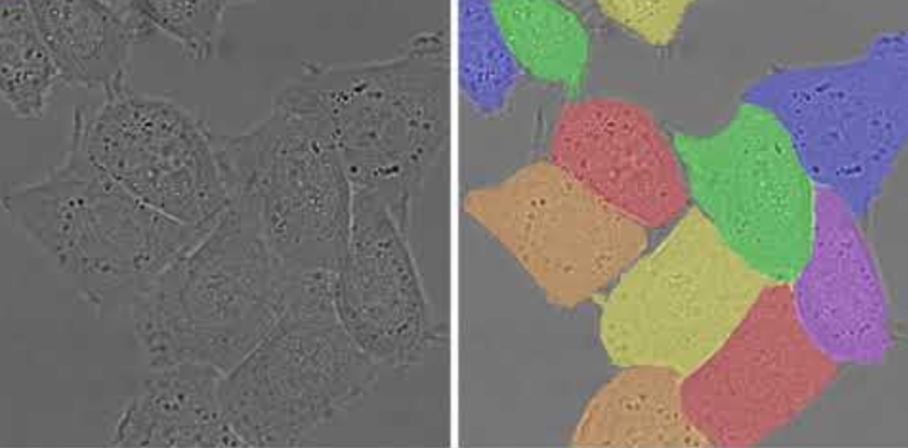
METHOD:
Use U-NET, a fully-convolutional network used for medical image segmentation.
Re-use this method for meteorite chondrules.
Example of HeLa cells segmented using U-NET
TEAM: EXTRATERRESTRIAL EFFERVESCENCE
CHALLENGE: 2D/3D METEORITE STRUCTURES

Slide 4
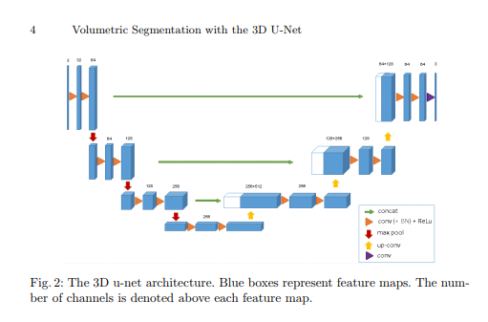
Our approach:
Use the U-net architecture introduced by Ronneberger et al
Encoder-decoder approach
Learn hierarchical features at different levels of detail
TEAM: EXTRATERRESTRIAL EFFERVESCENCE
CHALLENGE: 2D/3D METEORITE STRUCTURES

Slide 5
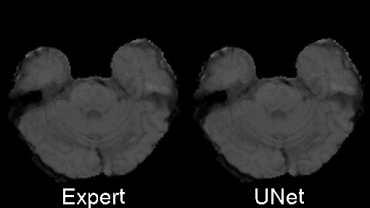
Medical application
Tumor segmentation
This segmentation was generated by training on only about 30 annotated samples
TEAM: EXTRATERRESTRIAL EFFERVESCENCE
CHALLENGE: 2D/3D METEORITE STRUCTURES

Slide 6
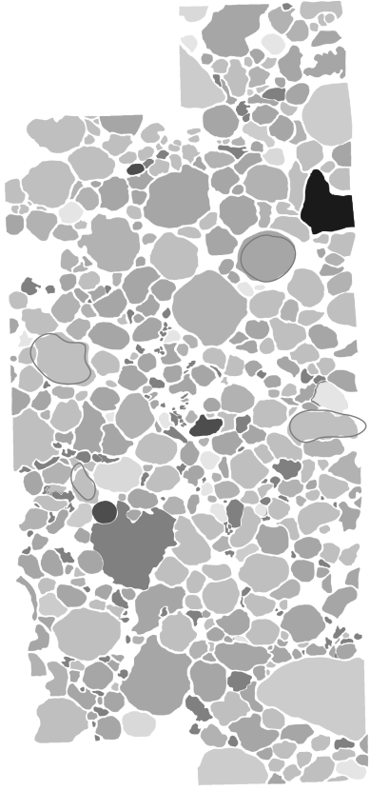

Our available data
High resolution annotated 2D slice
TIFF stack produced by CT scan of complete meteorite
High resolution slice can be divided in patches to get more samples to train on
TEAM: EXTRATERRESTRIAL EFFERVESCENCE
CHALLENGE: 2D/3D METEORITE STRUCTURES

Slide 7
Benefit of U-net
Allow training on sparse sample of 2D data
Can generalize to segmenting the 3D data
Cicek et al were successful in training on as few as (7, 5, 21), manually annotated slices in 3 orthogonal directions
TEAM: TBD
CHALLENGE: 2D/3D METEORITE STRUCTURES

Slide 8
Current status
Deployed 2 different 3D U-net implementation in Google Cloud
Technical difficulties with obtaining access to resources (GPU)
Next step would be to obtain access to GPU in order to train efficiently
TEAM: TBD
CHALLENGE: 2D/3D METEORITE STRUCTURES

Slide 9
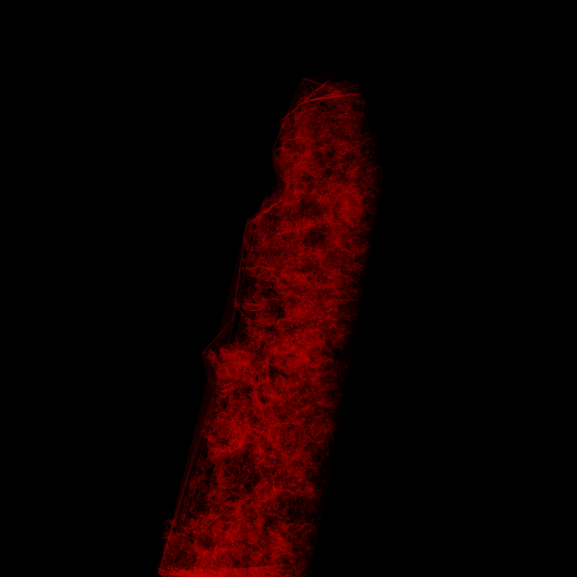
Illustration of 3D segmentation output
TEAM: EXTRATERRESTRIAL EFFERVESCENCE
CHALLENGE: 2D/3D METEORITE STRUCTURES

